Slide 1
Predicting SpaceX Falcon 9 First-Stage Landing Success
Geethima Rajapaksha
October 2026

Slide 2



OUTLINE
Executive Summary
Introduction
Methodology
Results
  Visualization – Charts
  Dashboard
Discussion
  Findings & Implications
Conclusion
Appendix

Slide 3
EXECUTIVE SUMMARY
Project Objective: Analyze historical SpaceX Falcon 9 launch data to identify key success factors and build predictive machine learning models to forecast first-stage landing success.
Key Findings (EDA & Visual Analytics):
  Launch success improved dramatically from 0% (2010–2013) to approximately 85% by 2019.
  KSC LC-39A achieved the highest share of successful launches (41.7%).
  Orbits such as ES-L1, GEO, HEO, and SSO maintained a 100% success rate, while heavy geostationary transfers (GTO) proved more challenging.
Predictive Modeling Results:
  All four classification models (Logistic Regression, SVM, Decision Tree, and KNN) achieved an identical test set accuracy of 83.33%.
  Business Value:
    Accurate landing predictions and booster reusability enable SpaceX to lower mission costs significantly ($62M vs. $165M market baseline), securing a major competitive advantage.

Slide 4

INTRODUCTION
SpaceX saves money by reusing the Falcon 9 first stage.
Goal: predict whether the first stage will land successfully.
Key Questions:
  Which factors affect landing success?
  Has the success rate improved over time?
  Which model predicts best?

Slide 5

METHODOLOGY
Data collection
  SpaceX REST API (requests + json_normalize)
  Filtered to Falcon 9 launches
Data Wrangling
  Handled missing values
  Created the class label(1=landed, 0=did not land)
Exploratory data analysis (EDA)
  Visualizations(Matplotlib/seaborn) and SQL queries
Interactive visual analytics
  Folium map and Plotly Dash dashboard
Predictive analysis (classification)
  Standarized data, train/test split
  Tuned Logistic Regression, SVM, Decision Tree and KNN with GridSearchCV

Slide 6
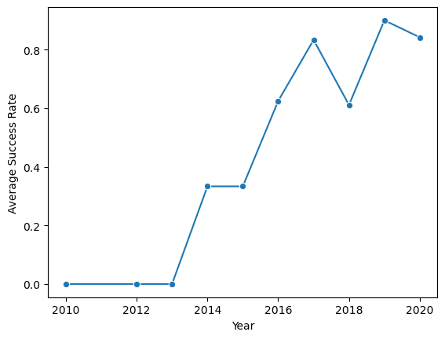
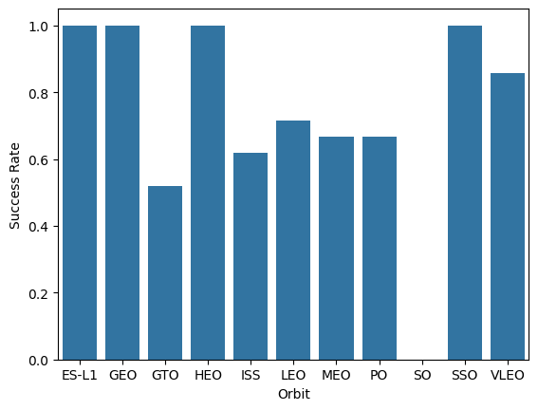
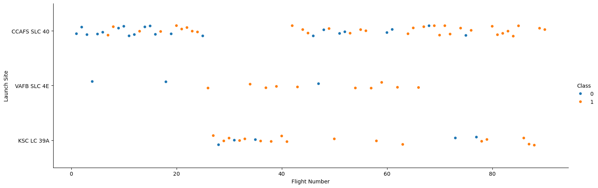
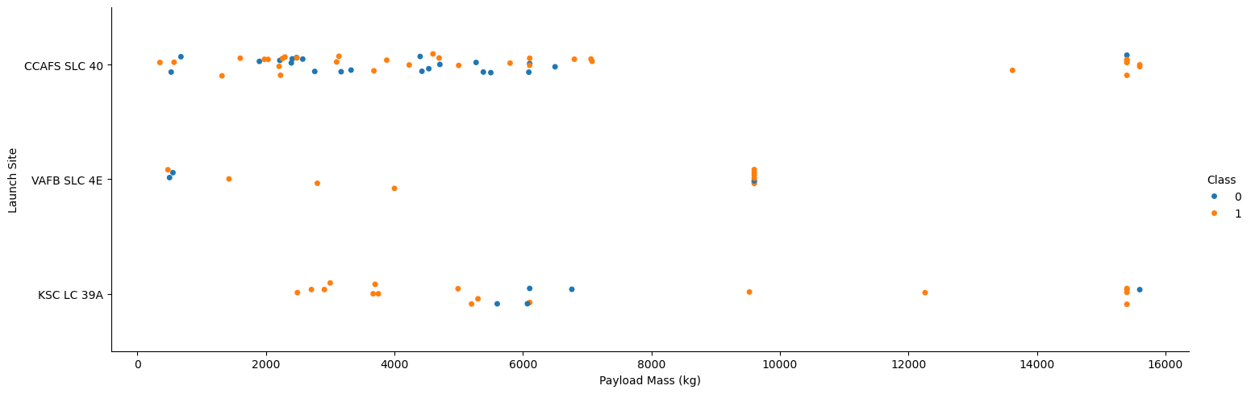
RESULTS
Success rate by year
Success rate by orbit
Flight Number vs Launch Site
Payload Mass vs Launch Site

Slide 7
EDA WITH SQL
Query 1:
SpaceX uses 4 launch sites
Query 2:
Landing outcomes
Launch_Site
CCAFS LC-40
VAFB SLC-4E
KSC LC-39A
CCAFS SLC-40

Slide 8
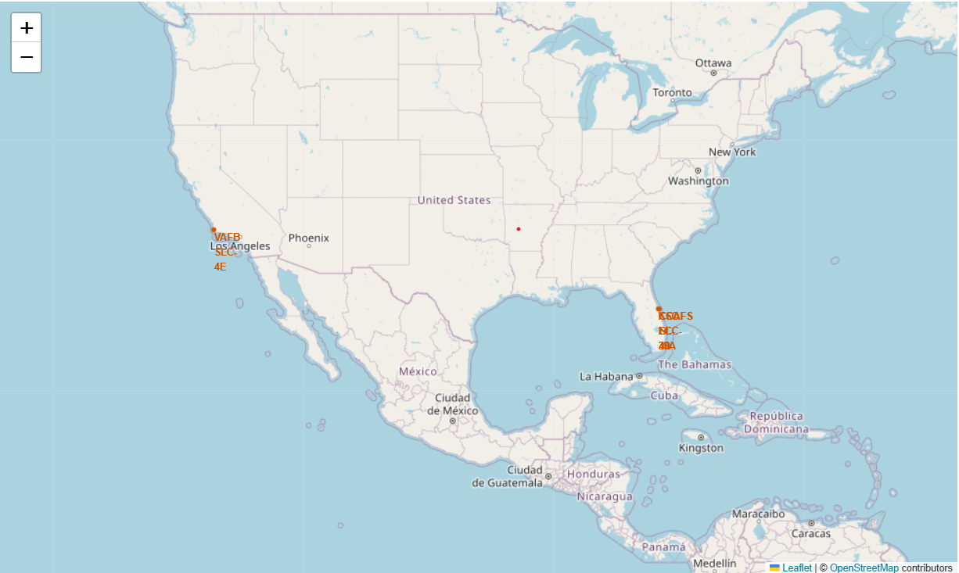
INTERACTIVE MAP WITH FOLIUM
Findings
All 4 launch sites are on the US coast
1 is in California and 3 are in Florida
Implications
Launching over the ocean keeps debris away from populated areas.
Southern sites get a speed boost from Earth's rotation

Slide 9
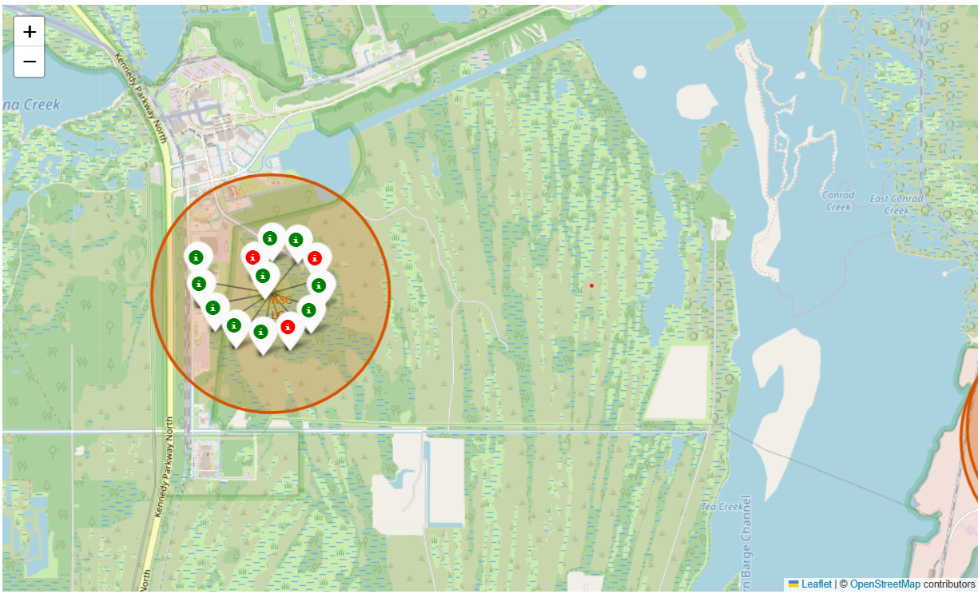
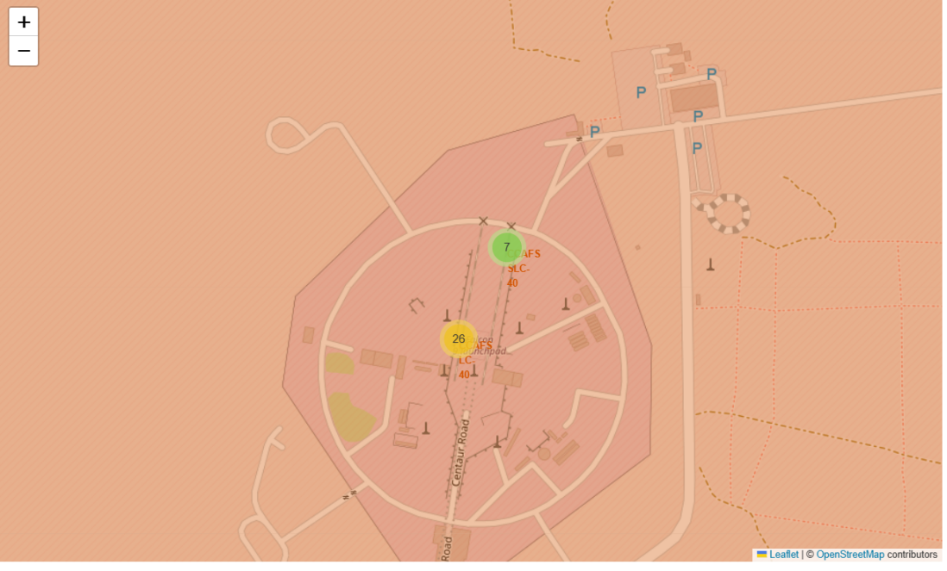
LAUNCH SUCCESS BY SITE(FOLIUM)
KSCLC-39A has 13 launches; CCAFS sites have 33. Green = success, red = failure.

Slide 10
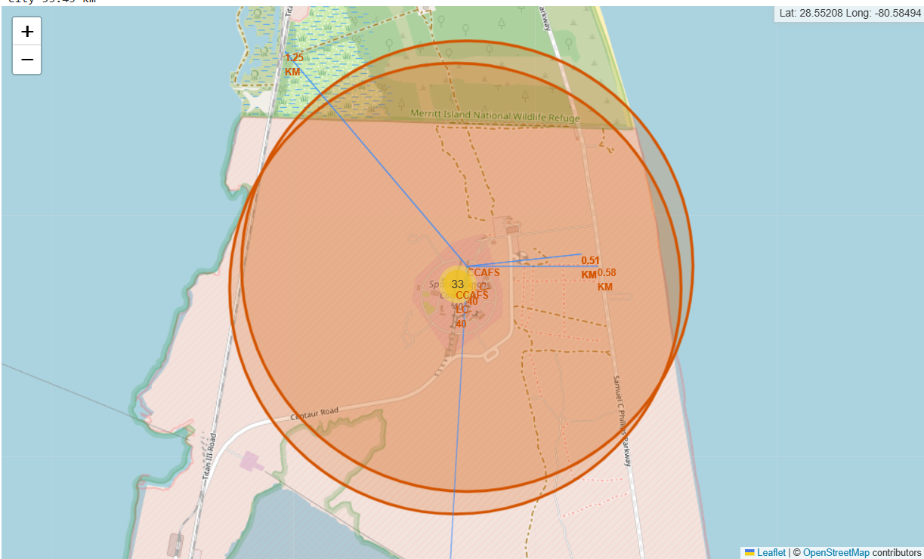
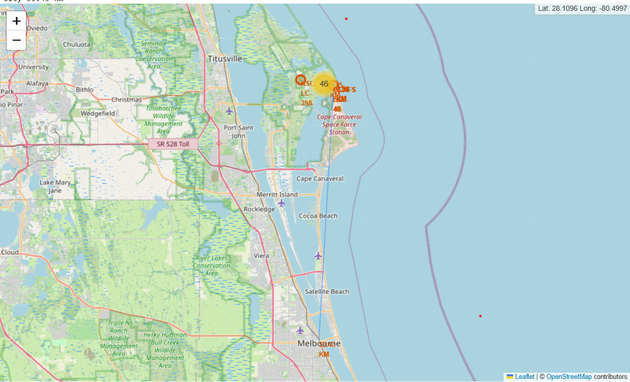
LAUNCH SITE PROXIMITIES(FOLIUM)
Findings
CCAFS is about 0.5km from the coast
It is close to a hightway (0.58km) and a railway (1.25km)
The nearest city is about 53 km away
Implications
Coastal sites let rockets launch over the ocean, away from people
Roads and rails make it easy to move rockets and equipment
Distance from cities limits the risk if a launch fails

Slide 11
DASHBOARD
ithub.com/Geethima-Rajapaksha/ibm-datascience-capstone-project/tree/Build-an-Interactive-Dashboard-with-Plotly-Dash

Slide 12
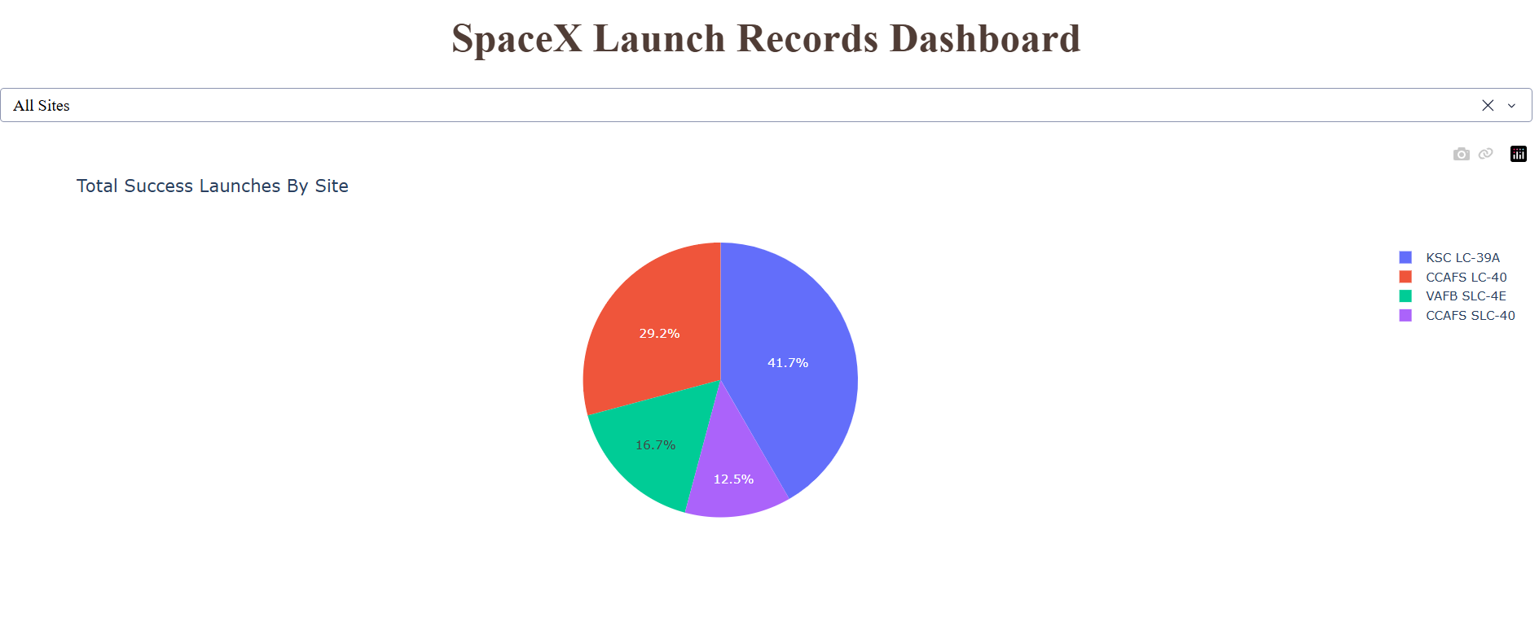
DASHBOARD TAB 1

Slide 13
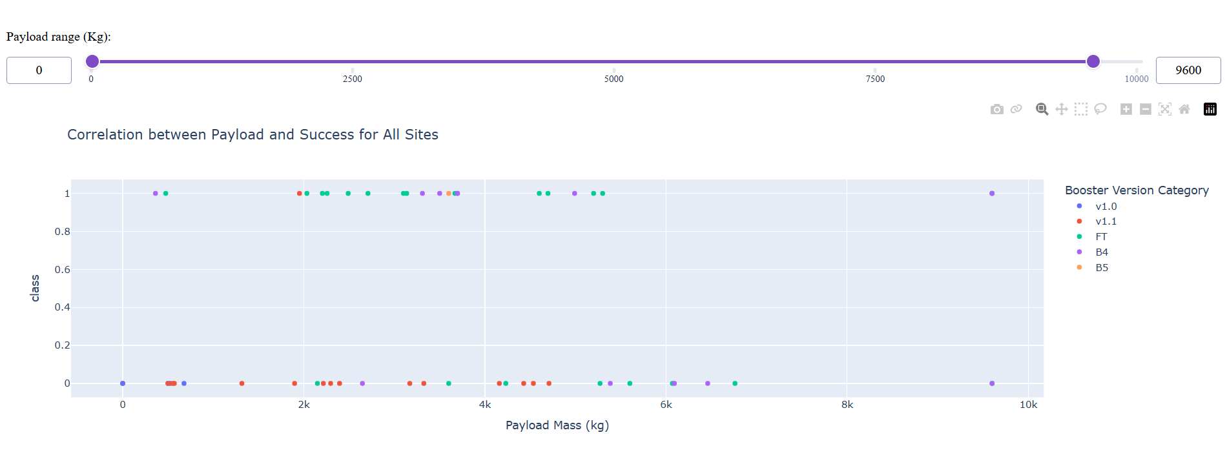
DASHBOARD TAB 2

Slide 14
DISCUSSION/ FINDINGS
Finding
KSC LC-39A Leader: KSC LC-39A had the highest proportion of successful launches at 41.7%.
Success Trajectory: Landing success rate increased significantly from 0% (2010–2013) to ~85% by 2019.
Geographic Strategic Location: All launch sites are located on US coasts, situated ~0.5 km from the nearest city (CCAFS).
Implications:
Safety Protocol: Coastal launch sites direct debris over the ocean, minimizing risk to populated areas.
Cost Advantage: Reusable boosters dramatically reduce spaceflight costs ($62M SpaceX vs $165M competitor baseline).
Key Factors: Launch site, payload mass, and booster version are essential predictive variables for landing success.

Slide 15
DATA PREPARATION AND PIPELINE
Machine Learning
Data Preprocessing
Created binary target vector y from column Class (Landing Success = 1, Failure = 0).
Created feature matrix X with One-Hot Encoded categorical variables.
Code line: y = df['Class'].to_numpy()
Standardization
Scaled features using StandardScaler() to ensure zero mean and unit variance across features.
Code line: X = StandardScaler().fit_transform(X)
Train/Test Split & GridSearch
Split data into training and test sets using train_test_split with an 80/20 ratio (random_state = 2).
Used GridSearchCV with 10-fold cross-validation for hyperparameter tuning.

Slide 16
CONCLUSION MATRIX EVALUATION
Confusion Matrix Evaluation
Predictive Analytics
(Note: All four models achieved an identical test set accuracy of 83.33% on 18 test samples)
Logistic Regression:
  Test Accuracy: 83.33%
  Confusion Matrix: True Negatives: 3 | False Positives: 3 | False Negatives: 0 | True Positives: 12
Support Vector Machine (SVM):
  Test Accuracy: 83.33%
  Confusion Matrix: True Negatives: 3 | False Positives: 3 | False Negatives: 0 | True Positives: 12
Decision Tree Classifier:
  Test Accuracy: 83.33%
  Confusion Matrix: True Negatives: 3 | False Positives: 3 | False Negatives: 0 | True Positives: 12
K-Nearest Neighbors (KNN):
  Test Accuracy: 83.33%
  Confusion Matrix: True Negatives: 3 | False Positives: 3 | False Negatives: 0 | True Positives: 12

Slide 17
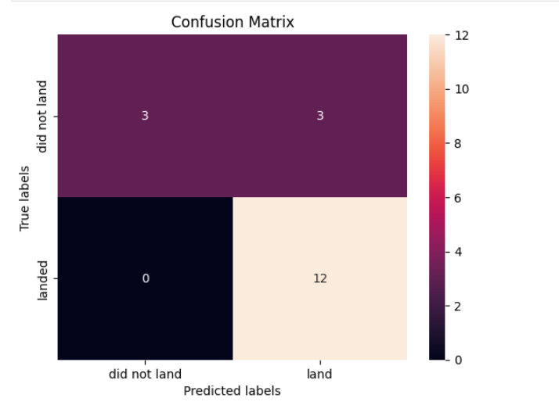
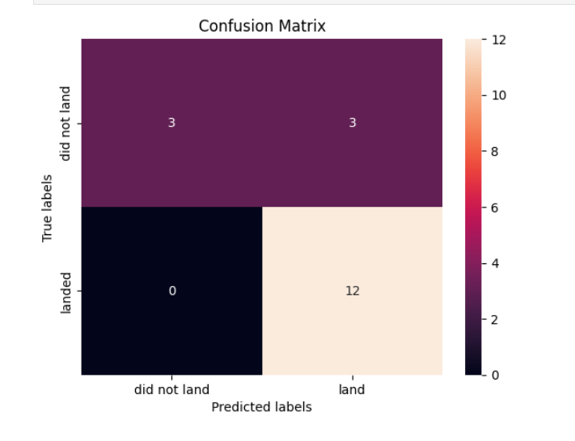
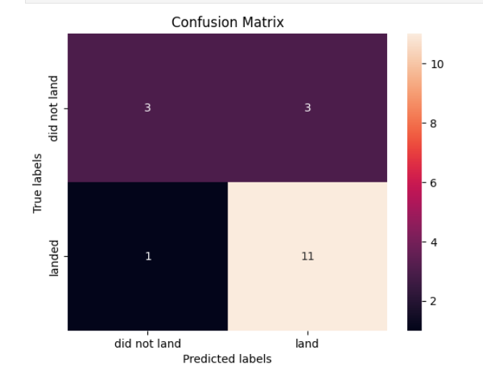
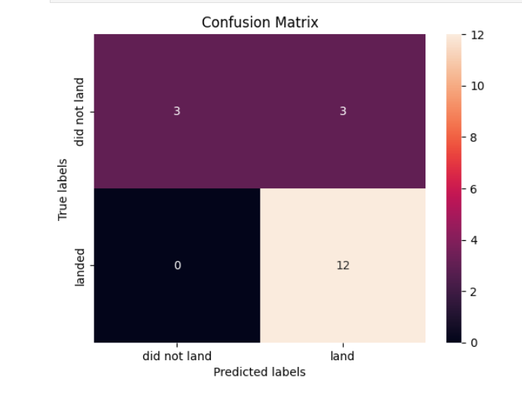
APPENDIX
Logistic Regression: 83.33%
Super Vector Machine (SVM): 83.33%
Summary:
All four tuned classification models achived the same test accuracy (83.33%).
Logidtic Regression or SVM is recommended for production due to lower computational complexity and better generalizability on binary landing classifications.
Decision Tree Classifier: 83.33%
K-Nearest Neighbors(KNN): 83.33%

Slide 18
CONCLUSION & FINAL TAKEAWAYS
Final Takeaways & Business Value
Conclusion
Predictive Performance: Achieved 83.33% accuracy in predicting first-stage Falcon 9 booster recovery using machine learning models.
Key Drivers: Payload mass (specifically in the 2,000–4,000 kg range) and launch site selection are critical indicators of landing success.
Business Value: Accurate landing predictions allow SpaceX to price launch contracts competitively ($62M vs $165M market baseline) while maintaining operational profitability.

Slide 19
EXPLORATORY DATA ANALYSIS – SUCCESS RATE VS. ORBIT TYPE
Exploratory Data Analysis (EDA)
Key Observations:
100% Success Rate Orbits: Missions targeting ES-L1, GEO, HEO, and SSO achieved a 100% landing success rate.
Moderate Success Rates: LEO (~71%), VLEO (~85%), and ISS (~62%) showed high-to-moderate success rates as launch techniques matured over time.
Challenging Orbits: GTO had a lower success rate (~52%) due to higher payload masses and higher re-entry speeds required for geostationary transfer.
Lowest Success Rate: SO (Polar Orbit) had a 0% success rate during early test launches.
Strategic Insight:
Orbit selection directly affects the booster’s re-entry velocity and remaining fuel, which dictates whether a drone ship or ground pad landing is feasible.

